Slide 1

Screening for disease
Social
problem should be important for the individual and community. Diagnostic follow-up and intervention should be available to all who require them. Favorable cost-benefit ratio. High public acceptance
Scientific
natural history should be adequately understood. Identification should occur prepathogenesis with sufficient lead time. Sound case definition and policy regarding whom to treat as patients. Knowledge base exist on efficacy of prevention and occurrence of side effects. The prevalence of the disease is high
Ethical
have evidence that the program can alter the natural history of the condition in a significant proportion of those screened. Suitable, acceptable tests.

Slide 2
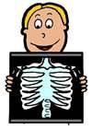
Characteristics of a good screening test
Simple
Rapid
Inexpensive
Safe
Acceptable

Slide 3
Criteria for Assessing Screening/Diagnostic Instruments
Sensitivity: the instrument’s ability to correctly identify a “case”—i.e., to diagnose a condition
Specificity: the instrument’s ability to correctly identify noncases, that is, to screen out those without the condition
The specificity of a screening tool is of upmost importance when there are a magnitude of negative implications that might result from reporting a positive result when in fact it is not positive.
For example, telling a pregnant women that she is H1N1 positive when in fact she is not

Slide 4
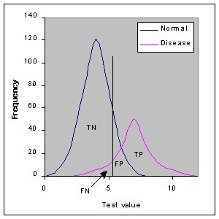
 | Disease + | Disease -
Test + | TP _{a} | FP _{b}
Test - | FN _{c} | TN _{d}
Sensitivity a/a+c
Specificity d/b+d
A test that produces a low number of FN results would have a high level of sensitivity.
A test that produces a low number of FP results would have a high level of specificity.
Important relationship between sensitivity and specificity: in that a screening test that produces a low number of false negative results would have a high number of true positives and thus a high level of sensitivity as well.

Slide 5
An instrument’s specificity is its rate of yielding “true negatives”. d/b+d
For example , if the case or condition of interest is pregnancy, a true negative is when a women is not pregnant and the screening test for pregnancy correctly identifies that she is not pregnant.
An instrument’s sensitivity is its rate of yielding “true positives”. a/a+c
For example , if the case or condition of interest is pregnancy, a true positive is when a woman is pregnant and the screening test for pregnancy correctly identifies that she is pregnant.

Slide 6
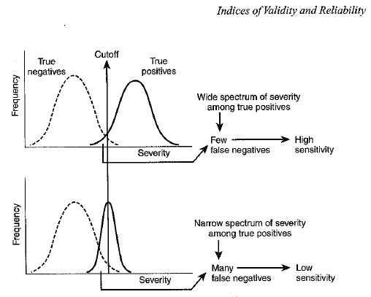

Slide 7
Predictive values
A screening program includes both diagnostic and therapeutic components, and includes the screening test and follow-up evaluations for those with positive tests.
Predictive value measures a screening program’s feasibility.
High positive predictive value is essential for successful screening program.

Slide 8
 |  | Disease/condition
 |  | present | absent | total
 | Test positive | a | b | a+b
 |  | True positive | False positive
 | Test negative | c | d | c+d
 |  | False negatives | True negatives
 | total | a+c | b+d
Predictive value (+), PVP
Proportion screened positive who actually have disease;
predictive value(+)= a/a+b TP / (TP+FP)

Slide 9
 |  | Disease/condition
 |  | present | absent | total
 | Test positive | a | b | a+b
 |  | True positive | False positive
 | Test negative | c | d | c+d
 |  | False negatives | True negatives
 | total | a+c | b+d
Predictive value (-), PVN
Proportion screened negative who actually are negative
predictive value (-)= d/c+d TN / (TN+FN)

Slide 10
Ex: Low Prevalence Population
Use HIV screening test in one million people in which HIV prevalence = .001
 | D+ | D− | Total
T+
T−
Total | 1000 |  | 1,000,000
Since ⇒ Prev = (# of cases) / N Then ⇒ (# of cases) = Prev × N. For the illustration: (# of cases) = 0.001× 1,000,000 = 1000

Slide 11
Example: SEN & SPEC Low prevalence population
Use HIV screening test in one million people in which HIV prevalence = .001
 | D+ | D− | Total
T+
T−
Total | 1000 | 999,000 | 1,000,000
those free of disease 1,000,000 – 1,000 = 999,000

Slide 12
Example: SEN & SPEC Low prevalence example
This test has a SENsitivity = .99
Thus, it will pick up 99% of the cases
 | D+ | D− | Total
T+ | 990
T−
Total | 1000
TP = SEN × (# of cases)
= 0.99 × 1000 = 990

Slide 13
Example: SEN & SPEC Low prevalence example
It follows that:
 | D+ | D− | Total
T+ | 990
T− | 10
Total | 1000
False Negatives

Slide 14
Example: SEN & SPEC low prevalence example
This test has SPEC = .99
Thus, it will correctly identify 99% of the noncases
 | D+ | D− | Total
T+
T− |  | 989,010
Total |  | 999,000
TN = SPEC × noncases
= 0.99 × 999,000
= 989,010

Slide 15
Example: SEN & SPEC low prevalence example
It follows that:
 | D+ | D− | Total
T+ |  | 9,990
T− |  | 989,010
Total |  | 999,000
False Positives

Slide 16
Example PVP
The Predictive Value Positive is thus:
 | D+ | D− | Total
T+ | 990 | 9,990 | 10,980
T− | 10 | 989,010 | 989,020
Total | 1000 | 999,000 | 1,000,000
PVP = TP / (TP + FP) = 990 / 10,980 = 0.090
Strikingly low PVP! (even though SEN & SPEC are high)

Slide 17
Example PVN
The Predictive Value Negative is thus:
 | D+ | D− | Total
T+ | 990 | 9,990 | 10,980
T− | 10 | 989,010 | 989,020
Total | 1000 | 999,000 | 1,000,000
PVN = TN / (TN + FP) = 989010 / 989,020 = 0.99

Slide 18
Ex: High prevalence population
An HIV screening test is used in one million people. Prevalence in population is now 10%. SEN and SPEC are again 99%.
 | D+ | D− | Total
T+ | 99,000 | 9,000 | 108,000
T− | 1,000 | 891,000 | 892,000
Total | 100,000 | 900,000 | 1,000,000
Prevalence = 100000 / 1,000,000 = 0.10 = 10%
SEN = 99000 / 100,000 = 0.99
SPEC = 891,000 / 900,000 = 0.99

Slide 19
Example: PVP, PVN high prevalence population
An HIV screening test is used in one million people. Prevalence in population is now 10%. SEN and SPEC are again 99%.
 | D+ | D− | Total
T+ | 99,000 | 9,000 | 108,000
T− | 1,000 | 891,000 | 892,000
Total | 100,000 | 900,000 | 1,000,000
PVP = 99,000 / 108,000 = 0.92 (better PVP in high prev pop.)
PVN = 891,000 / 892,000 = 0.99

Slide 20
Effects of prevalence of disease on screening test results
Sensitivity and specificity are stable properties of a screening test and are unaffected by the prevalence of a disease
Predictive value is affected
As prevalence falls: PVP falls and PVN rises.

Slide 21
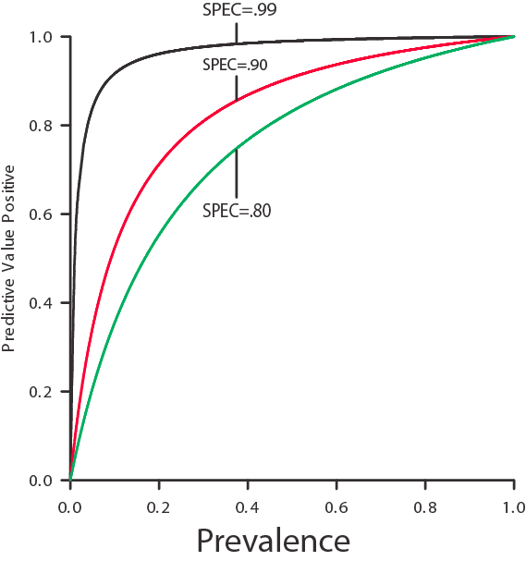
PVP and Prevalence
PVP is a function of PREV, Sen, & Spec
Low PREV ⇒ low PVP
Clinical implications
Low PVP is individual who has a positive screening test but would have a low probability of having the disease—so an invasive diagnostic procedure wouldn’t be warranted

Slide 22
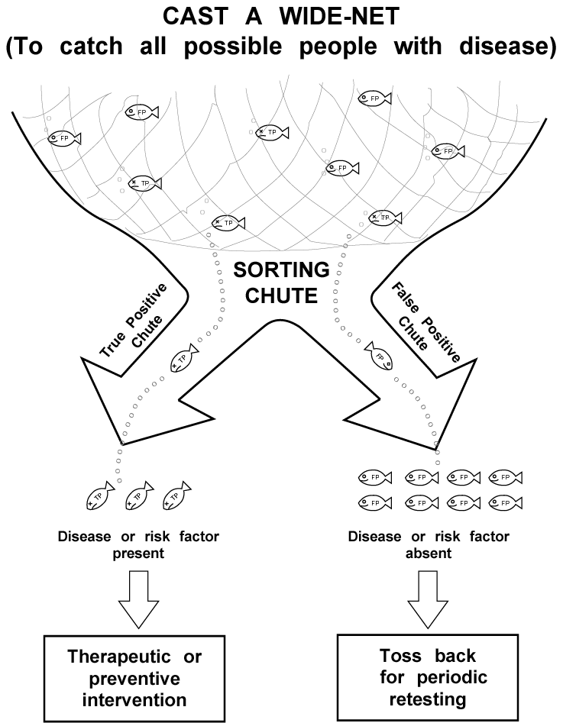
Screening Strategy
First stage ⇒ noninvasive, inexpensive, highly sensitive test (will usually have low PVP)
Second stage ⇒ sort out false positives from true positives (need higher SPECificity)

Slide 23
Cutoff Point
Sensitivity and specificity are influenced by cutoff point used to determine positive results
e.g., HIV optical density ratio (color change) continuous scale
At what point do we say the optical density is sufficiently dense to call the test positive?

Slide 24
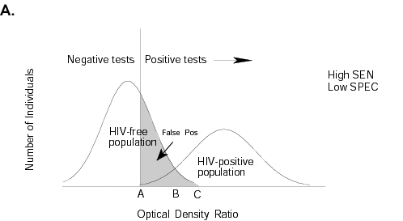
Low Cutoff
High sensitivity and low specificity

Slide 25
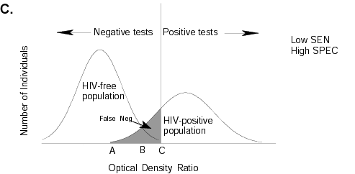
High Cutoff
Low sensitivity and high specificity

Slide 26
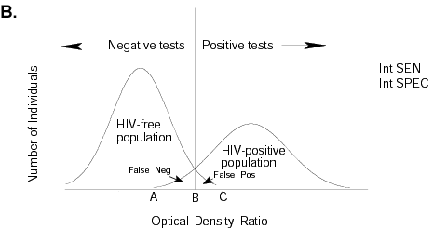
Intermediate Cutoff
moderate sensitivity & moderate specificity

